Slide 1
Final Project proposal
Analysis of effect of carbon monoxide poisoning in erroneous pulse oximeter readings
許逸翔 (6/19/2020)

Slide 2
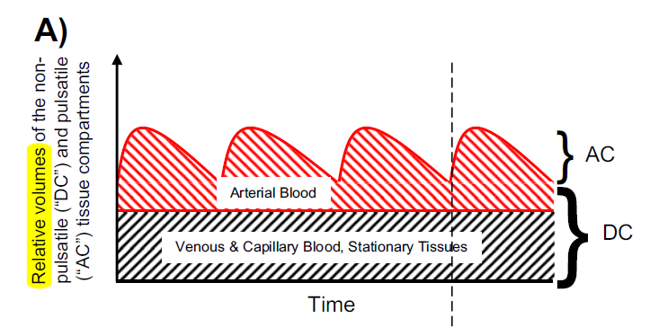
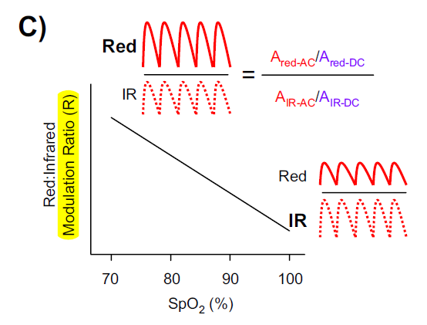
Brief principle of Pulse oximetry
Notes:
血液搏動可分為 AC. DC，透過足夠 pulse 的量測，可以有效去除靜脈的訊號

Slide 3
Carboxyhemoglobin (COHb) characteristic
An odorless, colorless, tasteless, and non-irritating gas.
Patients with CO poisoning may present with signs and symptoms that are non-specific, mimics of other disorders.
CO toxicity may be due to exposure from a variety of sources including propane-powered engine, natural gas, automobile exhaust, portable generators, gas log fireplaces, kerosene heaters, fire smoke, and paint strippers and spray paints as dichloromethane in these products gets metabolized to CO.
Notes:
一氧化碳的特色

Slide 4
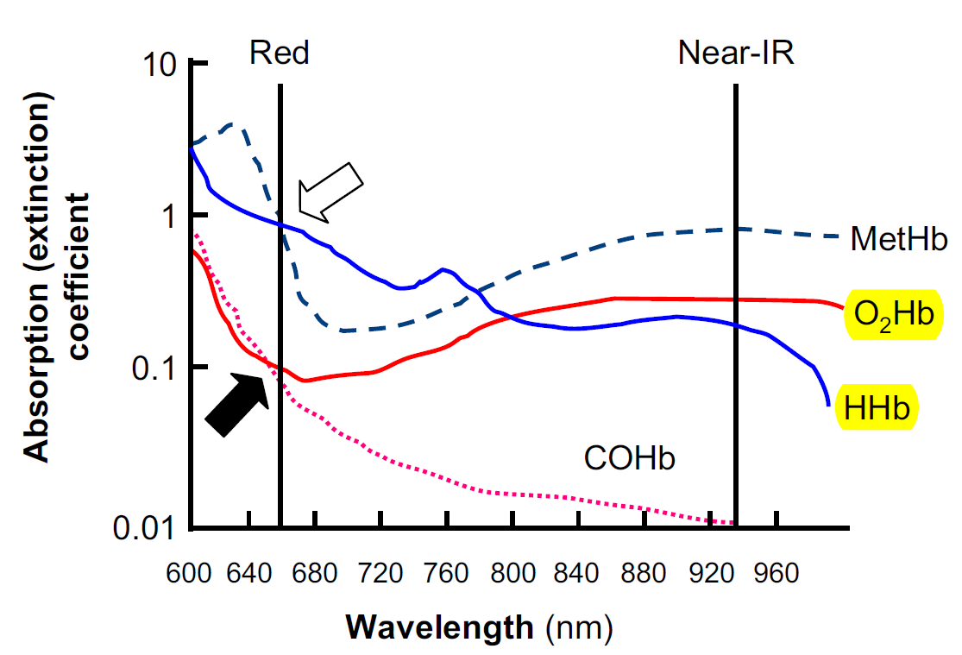
Carboxyhemoglobin (COHb) characteristic
The principal pathogenic mechanismof CO poisoning is the strong avidity of CO for Hb (240 greater than O₂), forming carboxy- Hb (COHb), reducing the O₂ carrying capacity of Hb and precipitating tissue hypoxemia.
O₂Hb and COHb absorb red light (660 nm) similarly and COHb absorbs very little near-IR light (940 nm)
Notes:
市售腦血氧儀其實就會用多個波長 (4-5個)
市售組織血氧儀其實也有 broad band
也可以去看看其他吸收物質帶來的變化

Slide 5
Carboxyhemoglobin (COHb) characteristic
The principal pathogenic mechanismof CO poisoning is the strong avidity of CO for Hb (240 greater than O₂), forming carboxy- Hb (COHb), reducing the O₂ carrying capacity of Hb and precipitating tissue hypoxemia.
O₂Hb and COHb absorb red light (660 nm) similarly and COHb absorbs very little near-IR light (940 nm)

Slide 6
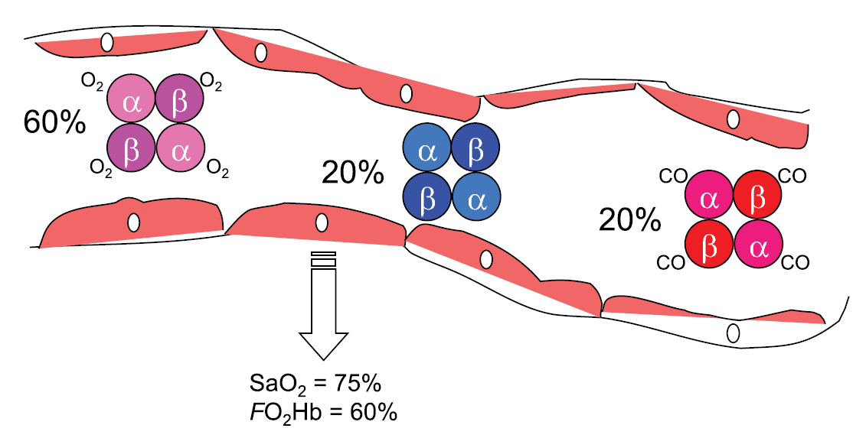
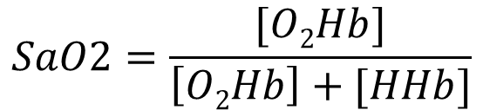
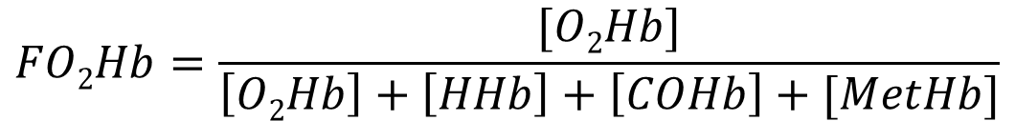
Why cause erroneous SaO2 reading ?
$$SaO2=\frac{[O2Hb]}{\left[O2Hb\right]+[HHb]}$$
$$FO2Hb=\frac{[O2Hb]}{\left[O2Hb\right]+\left[HHb\right]+\left[COHb\right]+[MetHb]}$$

Slide 7
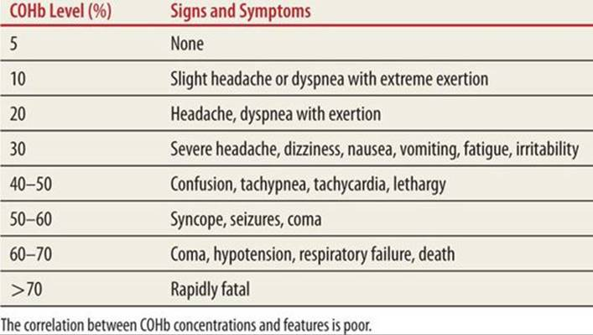
CoHb level and symptoms
https://doctorlib.info/pediatric/schafermeyers-pediatric-emergency-medicine/127.html

Slide 8
Procedure
Use modeling to know how CO level influence R value
固定 functional SaO2，添加適當比例的 COHb(1% - 20%)，觀察 R值 與 SpO2. FO2Hb 會如何變化
The result can tell us the incomplete part of our device. (two wavelength)
Notes:
去探討 CO level 與 R ratio 對應到的 SpO2 的性質
如果真的要解決定 CO 的影響，可能就需要多個波長
可以去 survey 目前市售的脈膊血氧儀，看有沒有多個波長的，是否已解決這個問題，也可以參考演算法
如果目前市售的都已經解決，那其實就不太有繼續去做的價值

Slide 9
參考資料
Pulse oximetry: Understanding its basic principles facilitates appreciation of its limitations (Chan ED, Chan MM, Chan MM, 2013)
Notes:
把各種參數的參考文獻列表，這樣 proposal 會比較精細 (scattering function. Molar extinction coefficient …等等)

